Slide 1
Honours Year Project
Abrie Greeff
Supervisor: Dr. van Zijl
www.cs.sun.ac.za/~agreeff/

Slide 2
Problem
SASL dictionary
Vast amounts of video data
Extracting necessary information
Low user input

Slide 3
Project Outline
Receive a set of MPEG2 video files
Split set into individual files
Generate hand movement data
Save a set of files by corresponding movements

Slide 4
Solution
Develop two applications
  Hand detection application
  Video cut application

Slide 5
Hand Detection Application
MPEG codec vs Integrated decoder
Video Noise
  20% Threshold
Movement
  Threshold
  Mean
  Standard Deviation
  μ − Edge threshold < RGB(i, j)

Slide 6
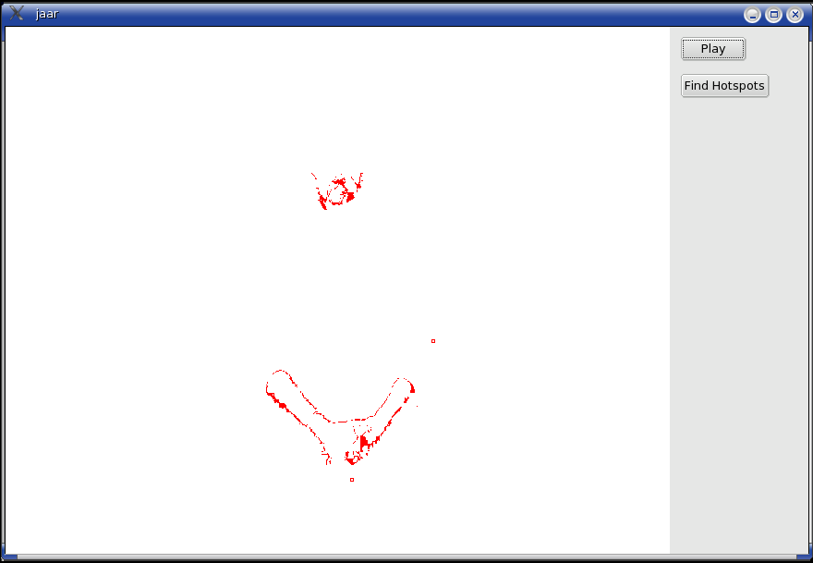
Hand Detection Application

Slide 7
Hand Detection Application
Isolate body parts
  Mask
Skin tone detection
  Equations for arms
  Mean and Standard Deviation from mask

Slide 8
Hand Detection Application
Movement tracking
  μ − Skin threshold < RGB(i, j)
  Test against Oriented Bounding Box
  Linear Least Squares
  Determine hand positions

Slide 9
Hand Detection Application
  #File Name
  /mnt/removable/jaar projek/PartA_008.mpg
  #Gesture
  Apple
  #Width Height Position_of_chin(x,y)
  720 576 364,205
  #Left(x,y) Right(x,y)
  3,-261 0,-263
  -3,-267 4,-268
  0,-261 3,-268
  -1,-260 3,-258
  2,-246 -2,-254
  -1,-245 5,-250

Slide 10
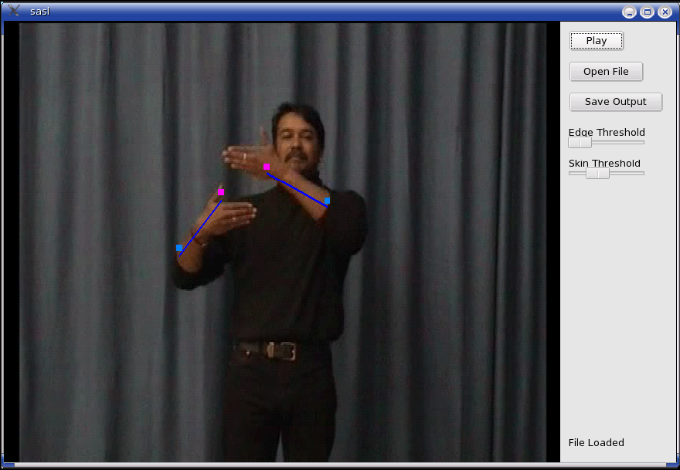
Hand Detection Application

Slide 11
Video Cut Application
Mean and standard deviation of movement
Five still frames seen as cut position
Minimum cut

Slide 12
Comments
Qt and Windows
MPEG2 only
Performance

